Slide 1
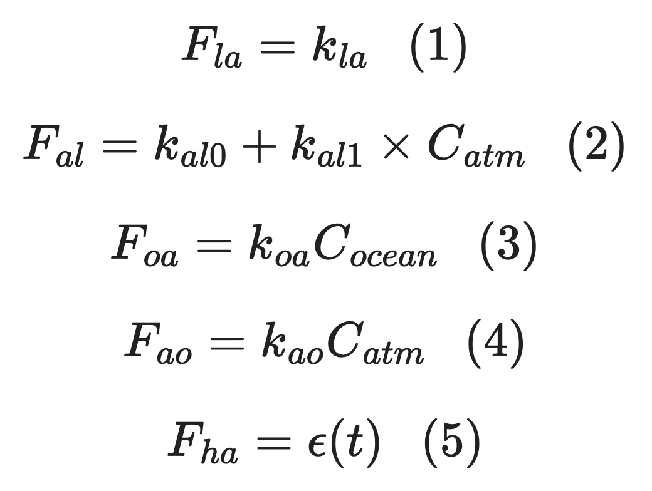
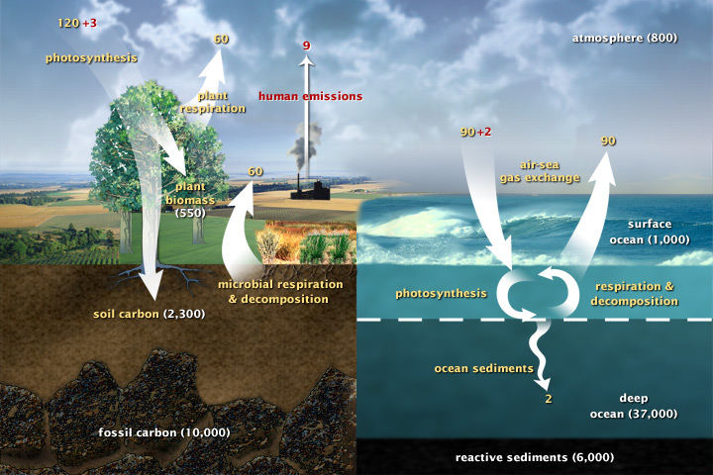
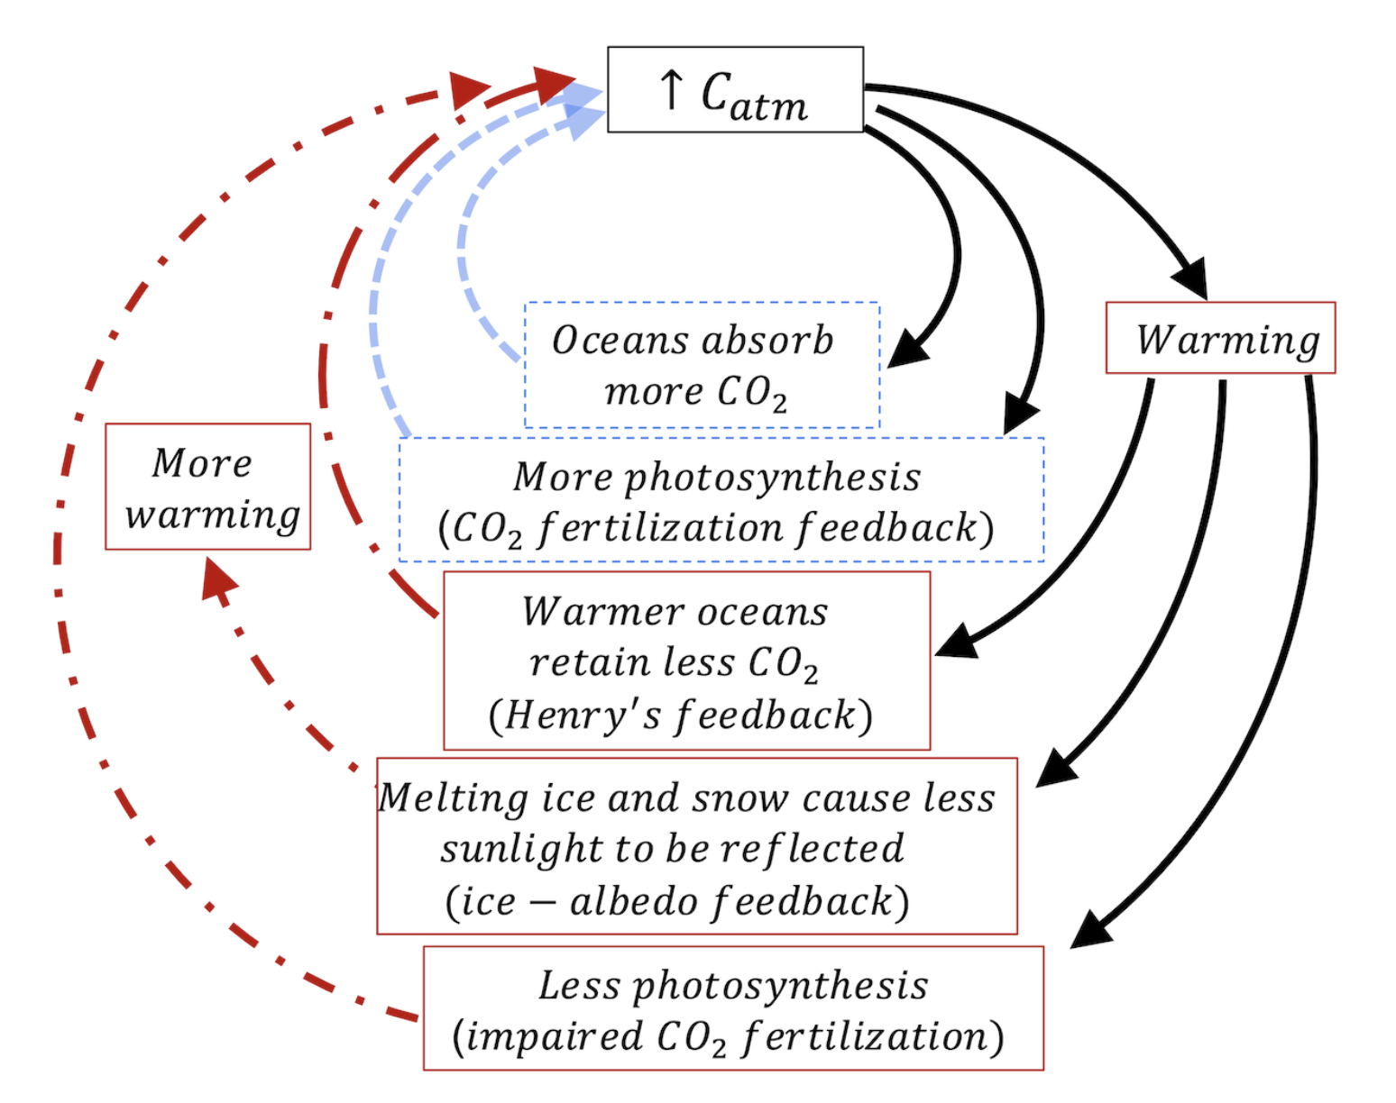
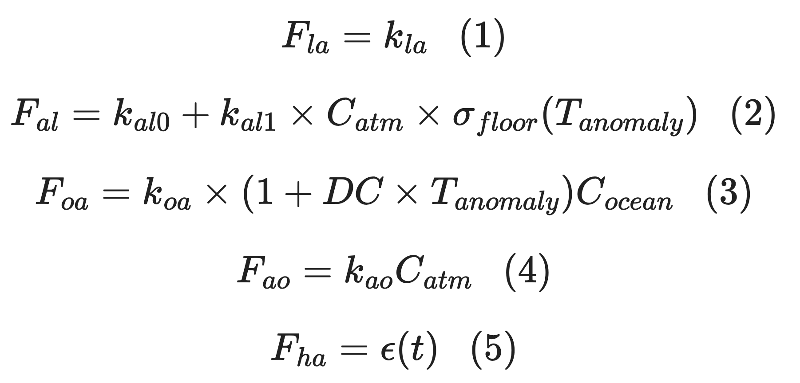
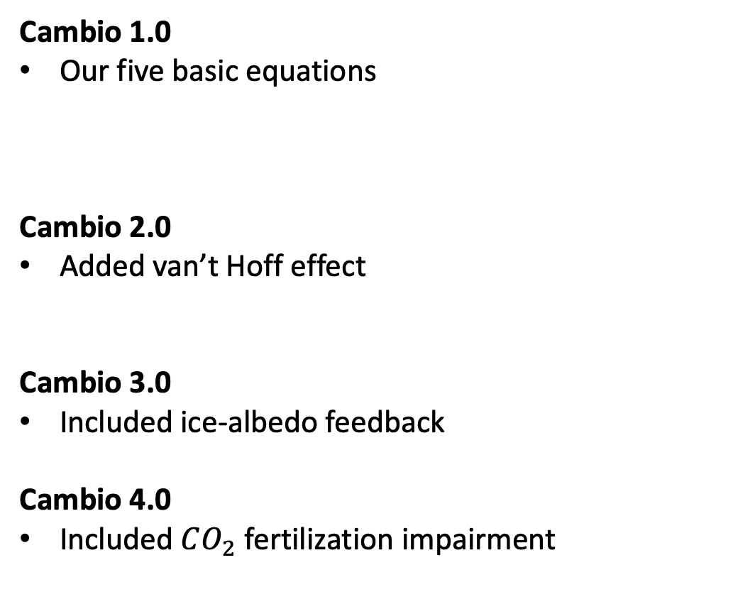
Summary of climate capabilities in Cambio 1-4
Cambio 1.0
Our five basic equations
Cambio 2.0
Added van’t Hoff effect
Cambio 3.0
Included ice-albedo feedback
Cambio 4.0
Included $CO_{2}$ fertilization impairment

Slide 2
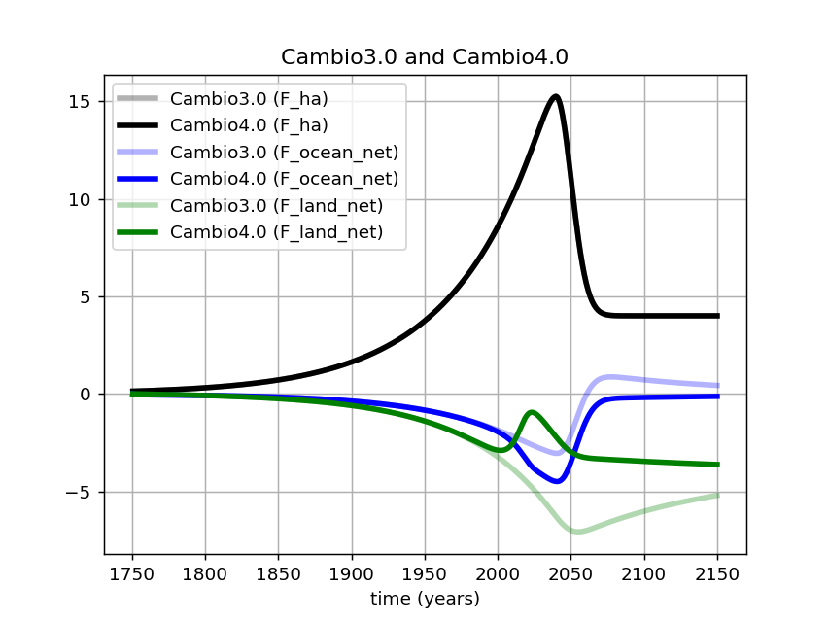
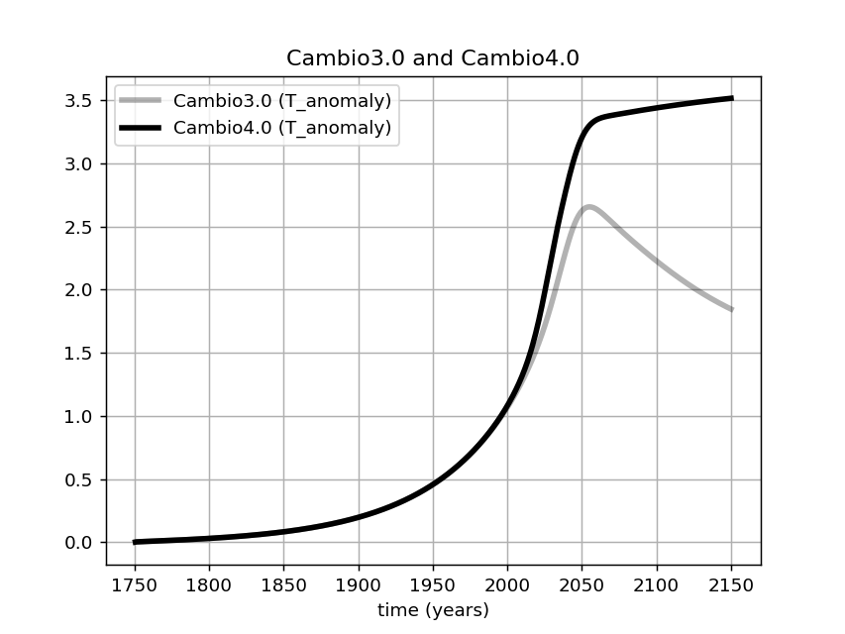
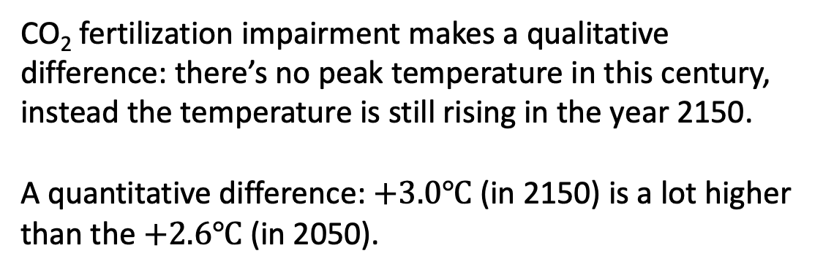
What can we learn from Cambio 4.0?
CO₂ fertilization impairment makes a qualitative difference: there’s no peak temperature in this century, instead the temperature is still rising in the year 2150.
A quantitative difference: $+3.0℃$ (in 2150) is a lot higher than the $+2.6℃$ (in 2050).

Slide 3
What can we learn from Cambio 4.0?
CO₂ fertilization impairment makes a qualitative difference: there’s no peak temperature in this century, instead the temperature is still rising in the year 2150.
A quantitative difference: $+3.0℃$ (in 2150) is a lot higher than the $+2.6℃$ (in 2050).
Also, we can see that oceans are increasing their absorption of CO₂ in compensation for the impairment in terrestrial CO₂ fertilization.

